Slide 1
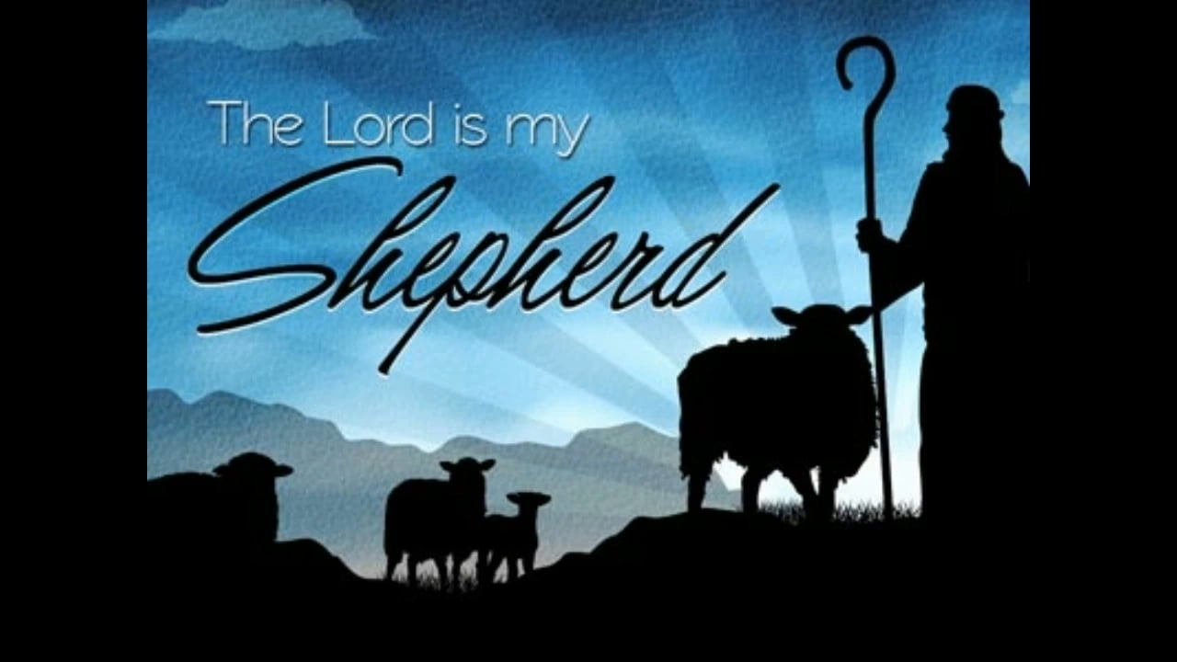
The 23rd Psalm Psalms of Guidance May 15, 2022

Slide 2
Psalms 23
1 The LORD is my shepherd; FAITH I shall not want. ASSURANCE
2 He maketh me to lie down in green pastures: CONTENTMENT he leadeth me beside the still waters. PEACE
3 He restoreth my soul: LIFE he leadeth me in the paths of righteousness for his name’s sake. LEADERSHIP

Slide 3
Psalms 23
4 Yea, though I walk through the valley of the shadow of death, CONFIDENCE I will fear no evil: COURAGE for thou art with me; COMPANIONSHIP thy rod and thy staff they comfort me. COMFORT
5 Thou preparest a table before me in the presence of mine enemies: PROVIDENCE thou anointest my head with oil; FAVOR my cup runneth over. JOY
6 Surely goodness and mercy shall follow me all the days of my life: MERCY and I will dwell in the house of the LORD for ever. IMMORTALITY

Slide 4
Comfort – “Thy rod and thy staff they comfort me”
God would use His rod to punish His enemies. Psalms 9:16; Proverbs 13:24; Isaiah 10:5-6 “The rod and correction give wisdom” (Proverbs 29:15)
The rod guides those who have gone astray back into the right path. Psalms 89:30-32
His staff leads to a place of comfort for His followers. cf. 1 Corinthians 10:13; 1 Thessalonians 4:13-18; Revelation 14:13
Notes:
Psalms 9:15-16 – “¹⁵ The nations have sunk in the pit that they made; in the net that they hid their own foot has been caught. ¹⁶ The Lord has made himself known; he has executed judgment; the wicked are snared in the work of their own hands.”
Proverbs 13:24 – “Whoever spares the rod hates his son, but he who loves him is diligent to discipline him.”
Isaiah 10:5-6 – “⁵ Ah, Assyria, the rod of my anger; the staff in their hands is my fury! ⁶ Against a godless nation I send him, and against the people of my wrath I command him, to take spoil and seize plunder, and to tread them down like the mire of the streets.”
Proverbs 29:15 – “The rod and reproof give wisdom, but a child left to himself brings shame to his mother.”
Psalms 89:30-32 – “³⁰ If his children forsake my law and do not walk according to my rules, ³¹ if they violate my statutes and do not keep my commandments, ³² then I will punish their transgression with the rod and their iniquity with stripes”
I Corinthians 10:13 – “¹³ No temptation has overtaken you that is not common to man. God is faithful, and he will not let you be tempted beyond your ability, but with the temptation he will also provide the way of escape, that you may be able to endure it.”
I Thessalonians 4:13-18 – “¹³ But we do not want you to be uninformed, brothers, about those who are asleep, that you may not grieve as others do who have no hope. ¹⁴ For since we believe that Jesus died and rose again, even so, through Jesus, God will bring with him those who have fallen asleep. ¹⁵ For this we declare to you by a word from the Lord, that we who are alive, who are left until the coming of the Lord, will not precede those who have fallen asleep. ¹⁶ For the Lord himself will descend from heaven with a cry of command, with the voice of an archangel, and with the sound of the trumpet of God. And the dead in Christ will rise first. ¹⁷ Then we who are alive, who are left, will be caught up together with them in the clouds to meet the Lord in the air, and so we will always be with the Lord. ¹⁸ Therefore encourage one another with these words.”
Revelation 14:13 – “And I heard a voice from heaven saying, ‘Write this: Blessed are the dead who die in the Lord from now on.’ ‘Blessed indeed,’ says the Spirit, ‘that they may rest from their labors, for their deeds follow them!’"

Slide 5
Providence – “Thou preparest a table before me in the presence of mine enemies”
The Lord’s people have no reason to fear evil (verse 4), even when they are in the presence of their enemies.
Genesis 39-40 Joseph.
Proverbs 28:25, “… he that putteth his trust in Jehovah shall be made fat.”
Psalms 37:25, “I have been young, and now am old; yet have I not seen the righteous forsaken, nor his seed begging bread.”
cf. Matthew 6:32-33
The enemy may seem to have the victory, but the saints always win. Revelation 13:10; 14:12-13; 17:14; 19:11-21; 20:4-6.
Notes:
Proverbs 28:25 – “A greedy man stirs up strife, but the one who trusts in the Lord will be enriched.”
Psalms 37:25 – “I have been young, and now am old, yet I have not seen the righteous forsaken or his children begging for bread.”
Matthew 6:32-33 – “³² For the Gentiles seek after all these things, and your heavenly Father knows that you need them all. ³³ But seek first the kingdom of God and his righteousness, and all these things will be added to you.”
Revelation 13:10 – “¹⁰ If anyone is to be taken captive, to captivity he goes; if anyone is to be slain with the sword, with the sword must he be slain. Here is a call for the endurance and faith of the saints.”
Revelation 14:12-13 – “¹² Here is a call for the endurance of the saints, those who keep the commandments of God and their faith in Jesus. ¹³ And I heard a voice from heaven saying, ‘Write this: Blessed are the dead who die in the Lord from now on.’ ‘Blessed indeed,’ says the Spirit ‘that they may rest from their labors, for their deeds follow them!’“
Revelation 17:14 – “¹⁴ They will make war on the Lamb, and the Lamb will conquer them, for he is Lord of lords and King of kings, and those with him are called and chosen and faithful.“
Revelation 19:11-21 – “¹¹ Then I saw heaven opened, and behold a white horse! The one sitting on it is called Faithful and True, and in righteousness he judges and makes war. ¹² His eyes are like a flame of fire, and on his head are many diadems, and he has a name written that no one knows but himself. ¹³ He is clothed in a robe dipped in blood, and the name by which he is called is The Word of God. ¹⁴ And the armies of heaven arrayed in fine linen, white and pure were following him on white horses. ¹⁵ From his mouth comes a sharp sword with which to strike down the nations, and he will rule them with a rod of iron He will tread the winepress of the fury of the wrath of God the Almighty. ¹⁶ On his robe and on his thigh he has a name written King of kings and Lord of lords. ¹⁷ Then I saw an angel standing in the sun, and with a loud voice he called to all the birds that fly directly overhead ‘Come, gather for the great supper of God, ¹⁸ to eat the flesh of kings, the flesh of captains, the flesh of mighty men, the flesh of horses and their riders, and the flesh of all men, both free and slave, both small and great.’ ¹⁹ And I saw the beast and the kings of the earth with their armies gathered to make war against him who was sitting on the horse and against his army. ²⁰ And the beast was captured, and with it the false prophet who in its presence had done the signs by which he deceived those who had received the mark of the beast and those who worshiped its image. These two were thrown alive into the lake of fire that burns with sulfur. ²¹ And the rest were slain by the sword that came from the mouth of him who was sitting on the horse, and all the birds were gorged with their flesh.”
Revelation 20:4-6 – “⁴ Then I saw thrones, and seated on them were those to whom the authority to judge was committed. Also I saw the souls of those who had been beheaded for the testimony of Jesus and for the word of God, and who had not worshiped the beast or its image and had not received its mark on their foreheads or their hands. They came to life and reigned with Christ for a thousand years. ⁵ The rest of the dead did not come to life until the thousand years were ended. This is the first resurrection. ⁶ Blessed and holy is the one who shares in the first resurrection! Over such the second death has no power, but they will be priests of God and of Christ, and they will reign with him for a thousand years.”

Slide 6
Favor – “Thou anointest my head with oil”
The Lord pours oil over their head, it is “good and pleasant” Psalms 133:1-2. Rejoicing the heart, Proverbs 27:9
To be anointed of the Lord is to:
Be chosen of the Lord.
The term “Christ,” means God’s anointed. cf. Hebrews 1:9
Be in His favor. cf. 1 Samuel 16:13
God has chosen and anointed certain ones today.
“IN CHRIST” NOT INDIVIDUAL! Ephesians 1:3-4
We are a chosen generation. 1 Peter 2:9
And in His favor. 2 Corinthians 4:6; Ephesians 1:16-19; 3:16-19
Notes:
Psalms 133:1-2 – “¹ Behold, how good and pleasant it is when brothers dwell in unity! ² It is like the precious oil on the head, running down on the beard, on the beard of Aaron, running down on the collar of his robes!”
Proverbs 27:9 – “Oil and perfume make the heart glad, and the sweetness of a friend comes from his earnest counsel.”
Hebrews 1:9 – “You have loved righteousness and hated wickedness; therefore God, your God has anointed you with the oil of gladness beyond your companions.“
I Samuel 16:13 – “Then Samuel took the horn of oil and anointed him in the midst of his brothers. And the Spirit of the Lord rushed upon David from that day forward. And Samuel rose up and went to Ramah.”
Ephesians 1:3-4 – “³ Blessed be the God and Father of our Lord Jesus Christ, who has blessed us in Christ with every spiritual blessing in the heavenly places, ⁴ even as he chose us in him before the foundation of the world, that we should be holy and blameless before him.”
I Peter 2:9 – “But you are a chosen race a royal priesthood a holy nation a people for his own possession, that you may proclaim the excellencies of him who called you out of darkness into his marvelous light.”
II Corinthians 4:6 – “For God, who said ‘Let light shine out of darkness,’ has shone in our hearts to give the light of the knowledge of the glory of God in the face of Jesus Christ.”
Ephesians 1:16-19 – “¹⁶ I do not cease to give thanks for you remembering you in my prayers, ¹⁷ that the God of our Lord Jesus Christ, the Father of glory may give you a spirit of wisdom and of revelation in the knowledge of him, ¹⁸ having the eyes of your hearts enlightened, that you may know what is the hope to which he has called you, what are the riches of his glorious inheritance in the saints, ¹⁹ and what is the immeasurable greatness of his power toward us who believe according to the working of his great might”
Ephesians 3:16-19 – “¹⁶ that according to the riches of his glory he may grant you to be strengthened with power through his Spirit in your inner being, ¹⁷ so that Christ may dwell in your hearts through faith – that you, being rooted and grounded in love, ¹⁸ may have strength to comprehend with all the saints what is the breadth and length and height and depth, ¹⁹ and to know the love of Christ that surpasses knowledge, that you may be filled with all the fullness of God.”

